Slide 1
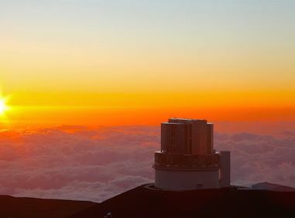
Understanding Mass Assembly of Luminous Red Galaxies in HSC
Amanda Newmark
Mentor: Elinor Medezinski
Princeton University– USRP 2016
Notes:
Is there any correlation between the Mass Assembly History and the underlying Dark Matter Halo in Luminous Red Galaxies (LRGs)?

Slide 2
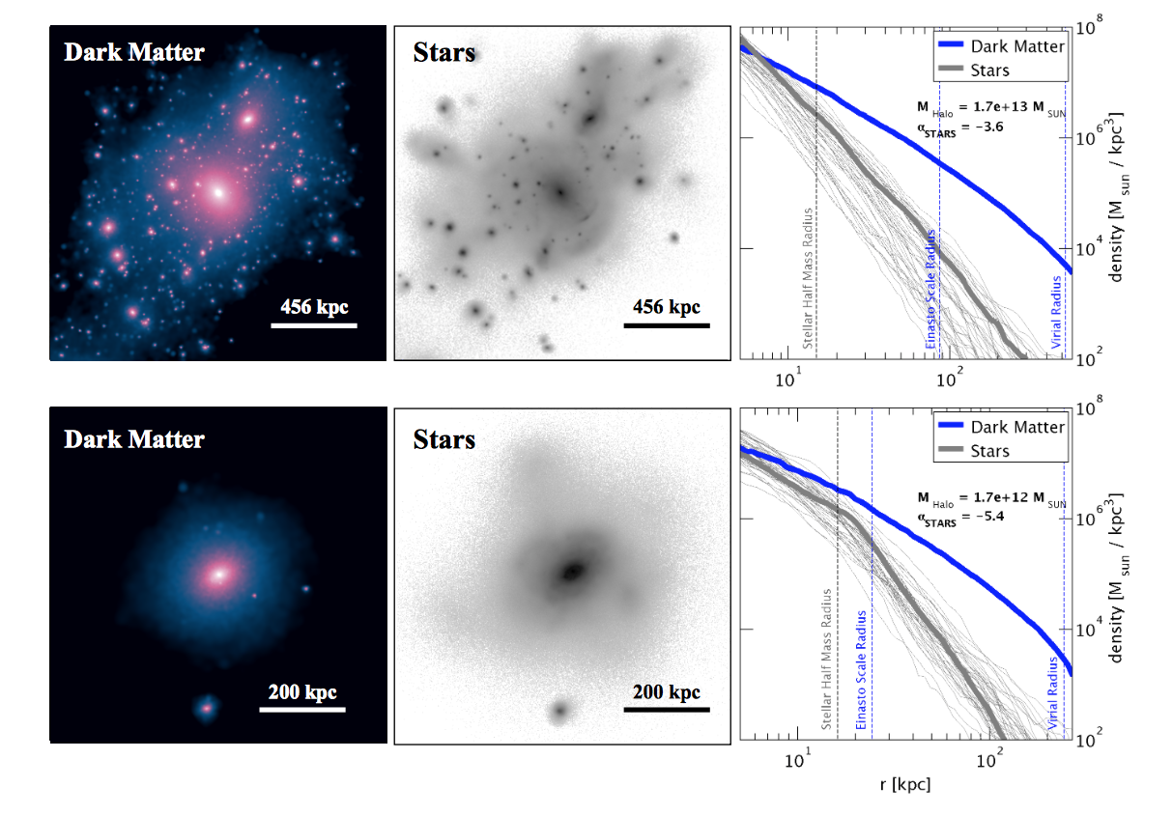
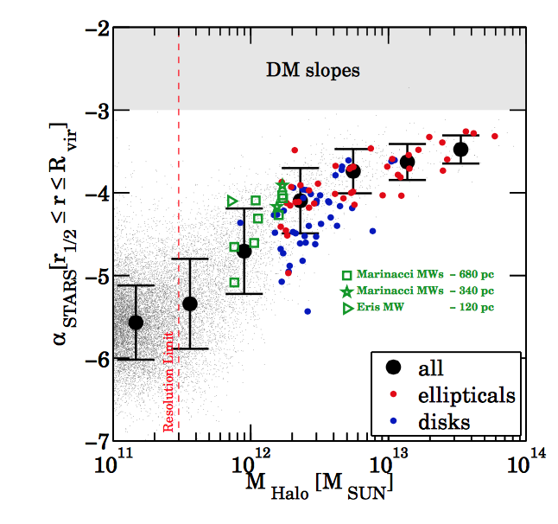
Mass Assembly
Elliptical
Disk
Pillepich et al 2014
Notes:
*Slopes of stellar envelopes direct evidence of the evolution of Cold Dark Matter Halos and their mass assembly histories.
We are interested in what governs the buildup of the envelope, merge with satellites, they build from the inside out, forming larger stellar envelopes. We focus on LRGs because they are a well defined, homogenous population: higher mass elliptical galaxies with little to no star formation.
2D projections of dark matter density and stellar light. Spherically averaged mass density. SIMULATIONS
we see the mass assembly of two different types of galaxies, a disk and an elliptical. is lumpier, showing how it is collecting the halos of different nearby galaxies. fit the outer averaged density profiles to a single power law. r1/2 to the virial radius
We eventually want to get our research to be the right-handed figure, plotting the relationship between the slope of the stellar halo and the total mass of the dark matter halo. LRGs are the red data points
coevolution of dark and visible matter throughout the formation of LRGs.. By fitting the slopes of the stacked luminosity profiles, we hope to connect the stellar envelope to the Dark Matter Halo

Slide 3
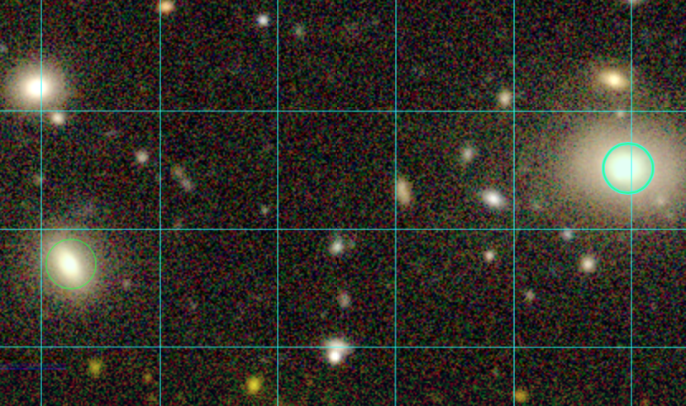
Hyper Suprime-Cam Survey
Layer | Area (deg²) | # of 1.8 deg² HSC fields | Filters& Depths
Wide | 1400 | 916 | grizy(r~26)
Deep | 27 | 15 | grizy+4NBs(r~27)
Ultradeep | 3.5 | 2 | grizy+4NBs(r~28)
No Flags
Close to Bright Star
Notes:
Main: correlation between a Luminous Red Galaxy’s mass assembly history and the DMHalo.
HSC is a multi-band imaging survey.. multi-aperture magnitudes for BOSS/LOWZ galaxies. HSC’s Wide layer fields. This is much deeper than Sloan, but doesn’t cover more sky. We can get higher redshifts
Other observational studies that use stellar profiles as a probe of mass assembly. However, HSC goes to very low surface brightness for more galaxies and can probe the envelope better.
test the photometric contamination caused by fainter galaxies that are not properly resolved. Our catalogue flags certain galaxies we suspect might contaminate our data, like saturation. necessary to disregard.
Bright Objects disregard? this is a conservative flag that means there is a nearby bright star that has been masked, overlaps with stellar envelope of galaxy. Appear brighter. Half remaining sample

Slide 4
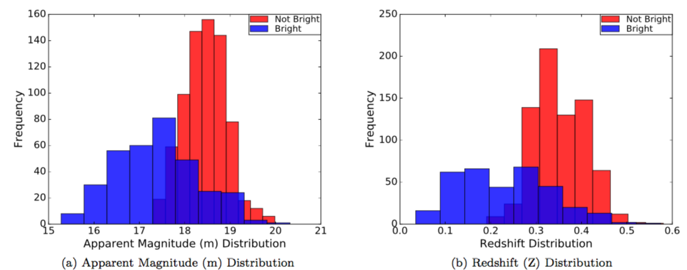
Flagged Galaxy Distributions
Notes:
we separate them into two populations, Bright Objects and not bright objects. plot the luminosity profiles of the individual galaxies.
Expect to see same population, but not normally distributed like the non-flagged galaxies. these galaxies were of lower redshift, they appear to be more luminous and offset our stacked profile.
lower limit of 0.2 to our redshift distribution.

Slide 5
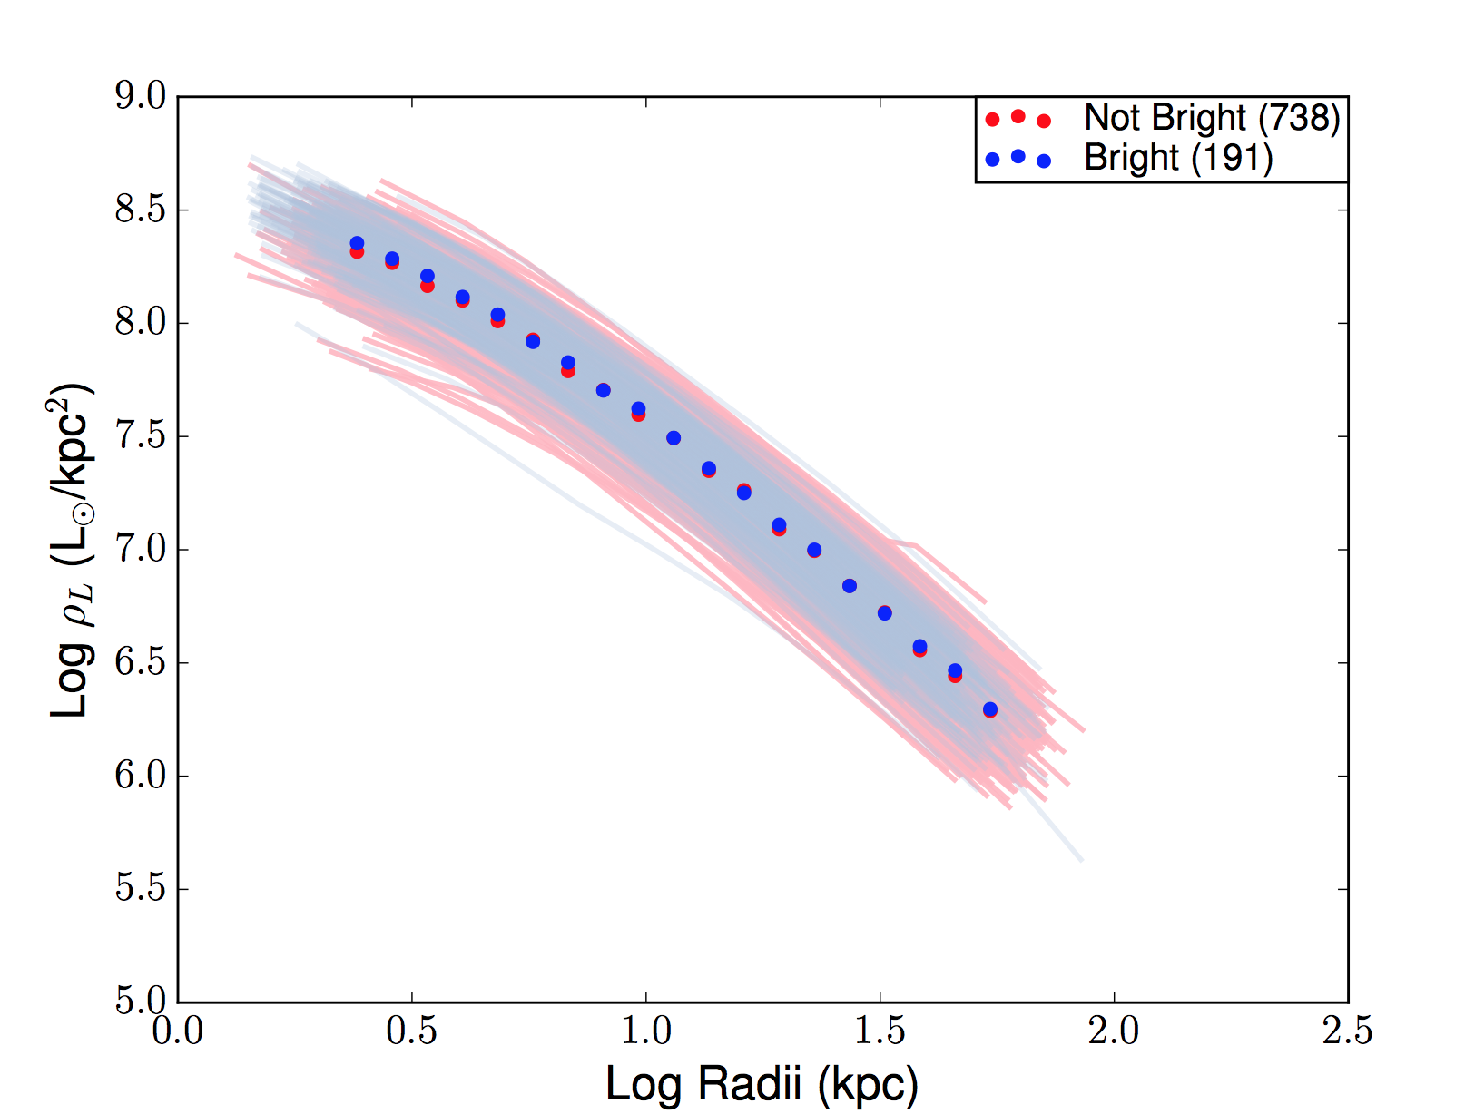
Making the Luminosity Profiles
Notes:
Made luminosity density profiles for bright (light blue) and not bright (light pink)
20 bins spaced evenly in logspace. 2 kpc and end at 80kpc. I weight each bin by the luminosity densities in each bin and divide by total number of data points per bin.
even numbers of bright galaxies and not bright galaxies in each bin.
increased the number of bins for our next step, when we calculate the logarithmic slope of the luminosity density profile.

Slide 6
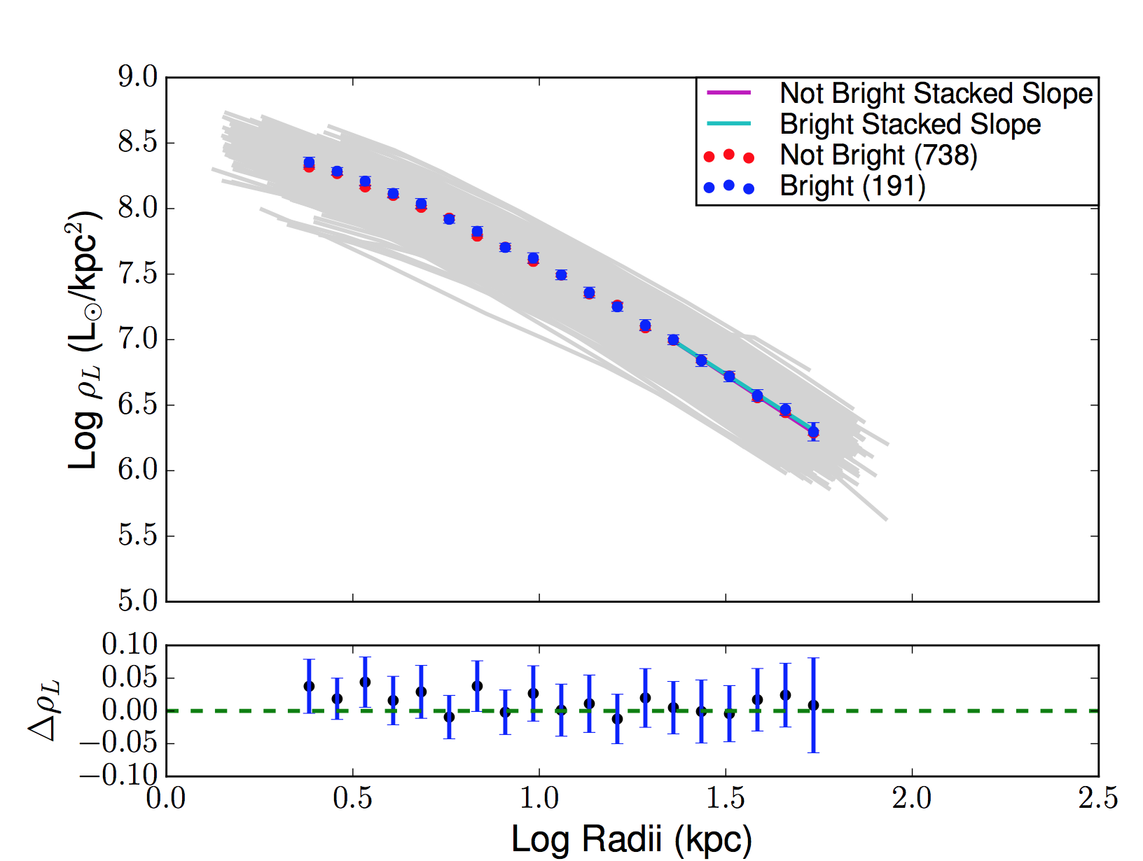
Flagged vs. Not Flagged
 | ⍺_{stars}
Not Bright | -1.86 ± 0.047
Bright | -1.809 ± 0.158
Notes:
we fit a line of best fit (using linear regression) to the stacked profile and the individual profiles.
homogenize our results, all fit to the same physical boundary, 3*r1/2 to r61/2. where we believe accretion is most promiment (outermost region)
half radii → marks inner boundary of the stellar envelope. since we are using HSC, which can probe very low magnitudes, we can take advantage of that when we measure the outermost envelope.
Virial radius too large. Setting limit avoid contamination from un-blended sources at the edge of bright galaxies’ envelopes.
Interestingly, we see that our stacked profiles for Bright Objects are in Agreement with our stacked profiles for Not Bright Objects

Slide 7
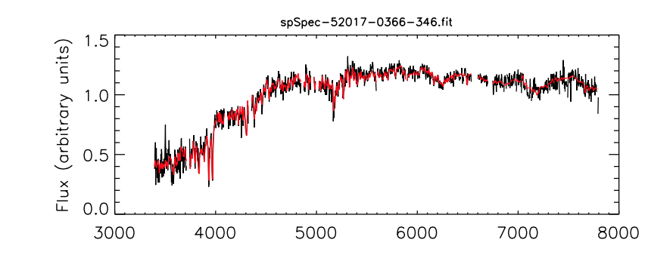
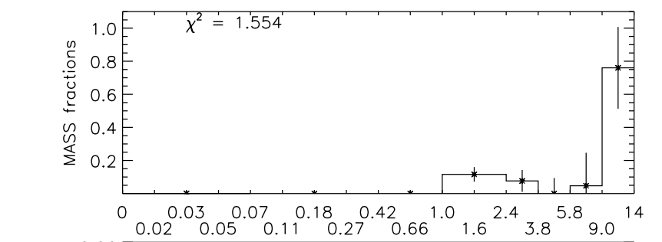
Star Formation History via VESPA
VESPA– an algorithm that fits the spectra of all LRGs
Tojeiro et al 2009
Notes:
main focus of this project is to find the relationship between mass assembly history and the dark matter halo.
Galaxy merger, accumulates more mass, visible aspects affected(distribution of stars in the stellar envelope). the Dark matter tidally disrupted. LRGs early-type galaxies→undergone mergers and accumulated most of their mass.
we first need to find if there is a correlation between mass assembly and star formation history.
Using a code that fits the spectra of all LRGs, we match to get their total spectral data (i.e. star formation histories)
distinguish them by SFH based on when they accumulated the most mass. most of their mass formed in the oldest age bin.
Since we are trying to connect when these mergers occur, it is necessary to separate into older and younger populations.

Slide 8
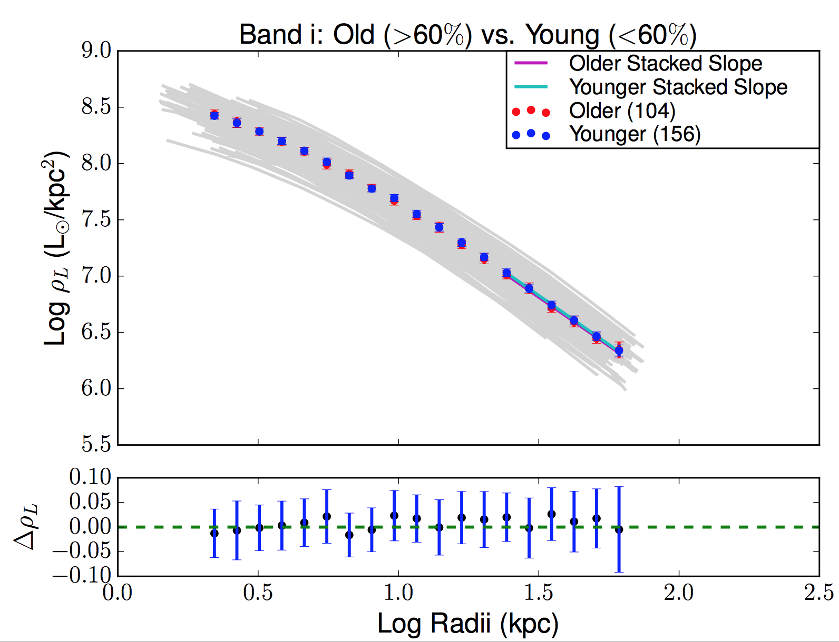
Old v Young Profiles
 | ⍺_{stars}
Older | -1.73 ± 0.142
Younger | -1.746 ± 0.12
Older, Bright | -1.586 ± 0.221
Older, Not Bright | -1.765 ± 0.1
Younger, Bright | -1.645 ± 0.299
Younger, Not Bright | -1.786 ± 0.094
Notes:
Slopes of the older and younger galaxies appear to be in agreement.
It is important to note that about half of the galaxies in each older and younger population are flagged as Bright Objects.
In the table that shows the Bright and not Bright stacked slopes for every subsample, we confirm that the flag has little effect on the overall luminosity profile.

Slide 9
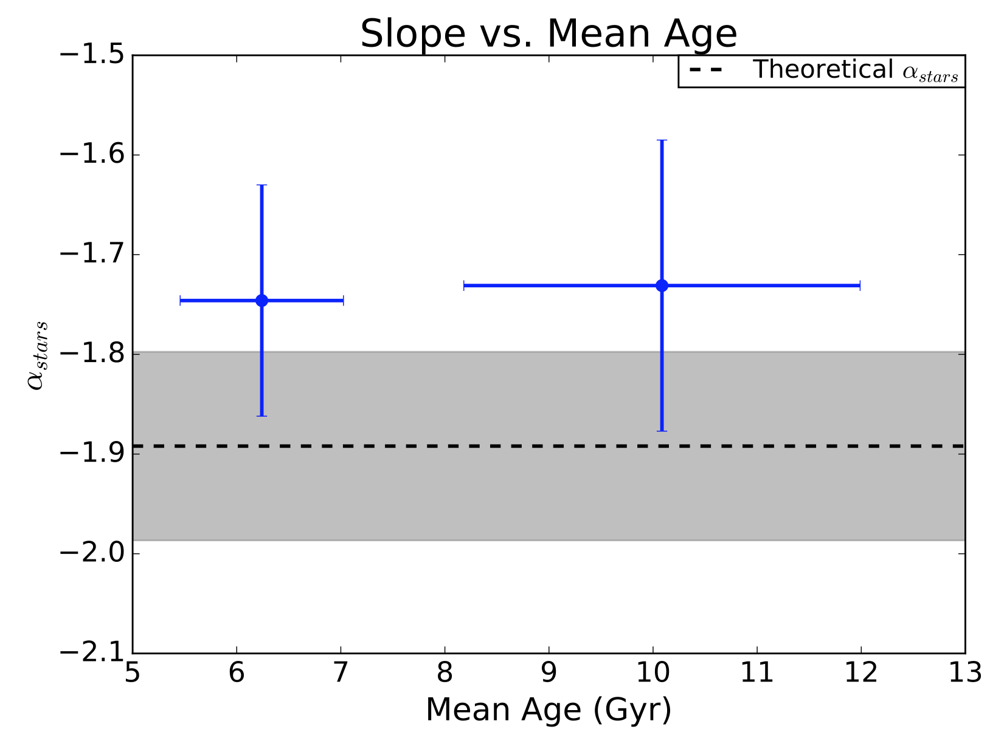
Slopes vs Median Age
Notes:
To further show this point, we show the relationship between mean age and slope.
Pillepich plotted the theoretical luminosity density to comoving distance for elliptical galaxies. As a frame of reference, we found the theoretical slope (alpha_stars) for the same stellar envelope range we used in our stacked slopes.
Slope not dependent upon the formation time. (1/100th of a difference). It is within 1/sigma of what we expect to get, according to Pillepich.

Slide 10
In Conclusion
Not necessary to remove bright objects
No correlation between accretion history and Star Formation Epoch
Slopes in agreement with simulations in this mass range
Notes:
As long as we fit slopes at same physical range
*dependent for lower mass end?
As determined by stellar envelope slope (alpha star)
No diff between different bands

Slide 11
Future Tests
The next step: Weak Gravitational Lensing to get total halo mass
Expand to other HSC Wide Fields
Othergalaxy populations (e.g. CMASS)
Pillepich et al 2014
Notes:
Use Gravitational Lensing to obtain the masses of all these galaxies and ultimately quantify the underlying Dark Matter Halo. Want to show dependence on Halo mass
LRGs might contain too narrow of a SFH range. Might want to use younger, more active bright galaxies. CMASS (doesn’t have color cut like LOWZ)

Slide 12
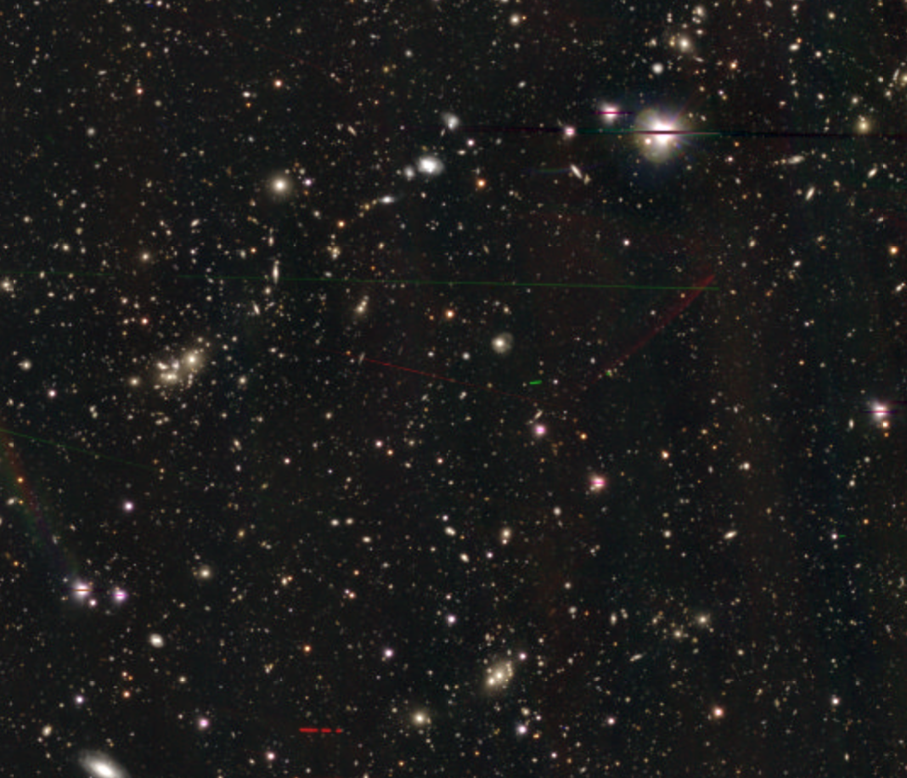
Thank You!

Slide 13
Explanation of Flags
Flags | Explanation
Saturated Center | Source’s center is close to saturated pixels
Cosmic ray | Sources footprint includes supected cosmic ray pixels
Bad pixels | Source in region labeled BAD
Suspect | Close to suspect pixels
Clipped | Source includes clipped pixels
Edge | Source in region masked EDGE or NO_DATA
Interpolated Centers | Sources centers include interpolated pixels

Slide 14
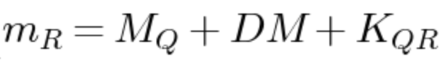
Relevant Equations
Distance Modulus:
Notes:
Hogg 2002

Slide 15
Examples of other observational studies
Iodice et al 2016: Fornax Deep Survey of NGC 1399 out to 192 kpc
D’Souza et al 2014: Parameterizing Stellar Halos of Galaxies
Bauer et al 2013: Links SFH and mass assembly for low-mass galaxies within Galaxy and Mass Assembly (GAMA) survey
Notes:
Iodice et al 2016- measured relationship of diffuse stellar halo of NGC 1399 and its star formation history
D’Souza- g and r band, 70-100kpc outer limit, SDSS DR9, understanding formation of Stellar halos
Bauer et al- links SFG and mass assembly using GAMA, doesn’t probe stellar envelopes

Slide 16
Bootstrapping for Errors

